Slide 1








Normal Labor & Delivery
NRS200-90

Slide 2
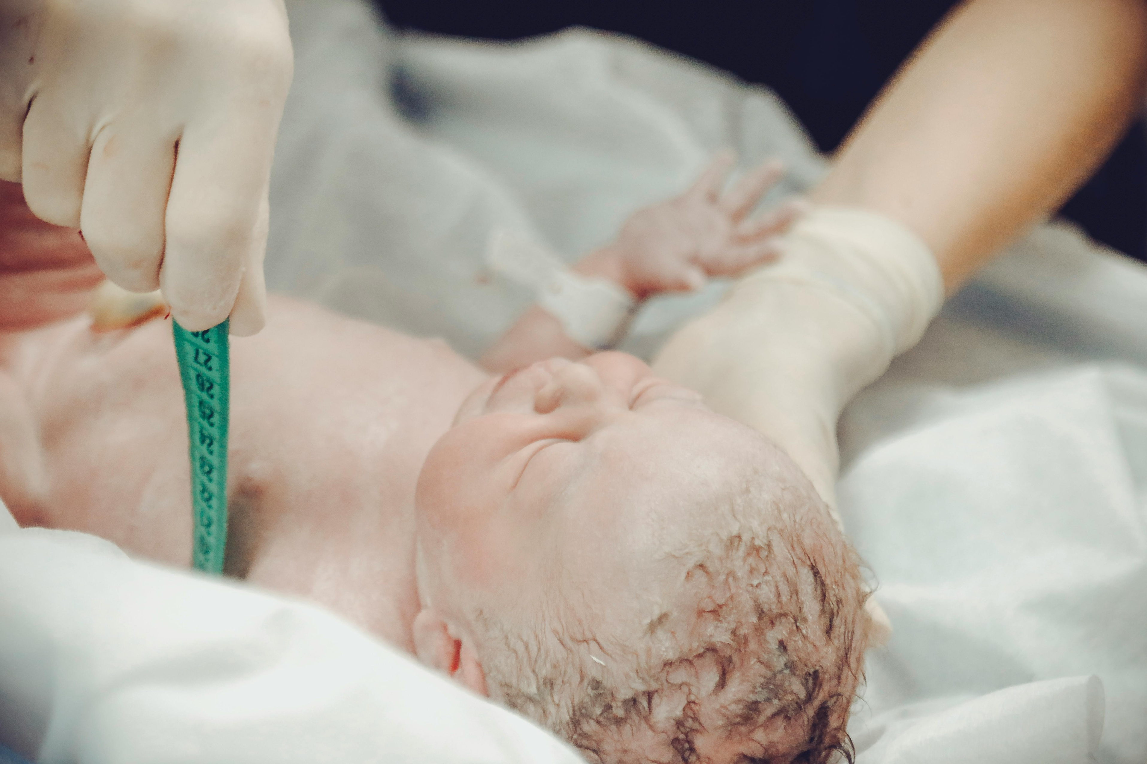


Learning Objectives
Describe the stages of labor.
Distinguish between true labor and false labor.
Explain the factors that affect the labor process.
Summarize the cardinal movements of labor.
Describe ongoing assessment of maternal progress during the first, second, third, and fourth stages of labor.
Describe fetal assessment during labor.
Compare nonpharmacologic and pharmacologic pain management strategies for comfort in labor.
Describe the role of the nurse during the first, second, third, and fourth stages of labor.

Slide 3


Options Surrounding Birth
Who can deliver a baby?
Obstetricians (OBGYNs)
Certified Nurse Midwives (CNMs)
Other professional midwives
Doulas
Hospital births:
Labor, delivery, recovery rooms (LDRs)
Labor, delivery, recovery, postpartum rooms (LDRPs)
Operating room
Alternative birthing environments:
Birth center
Home birth

Slide 4
Labor
Labor: process of moving fetus, placenta, and membranes out of the uterus through the birth canal
Includes the following:
1) Regular progression of uterine contractions
2) Progressive effacement and dilation of the cervix
3) Progressive descent of the presenting part.
Onset of labor: single cause is unknown; believed to be caused by many factors coming together

Slide 5
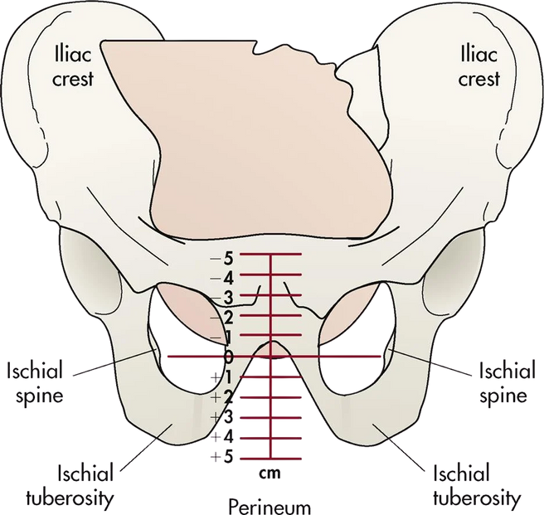
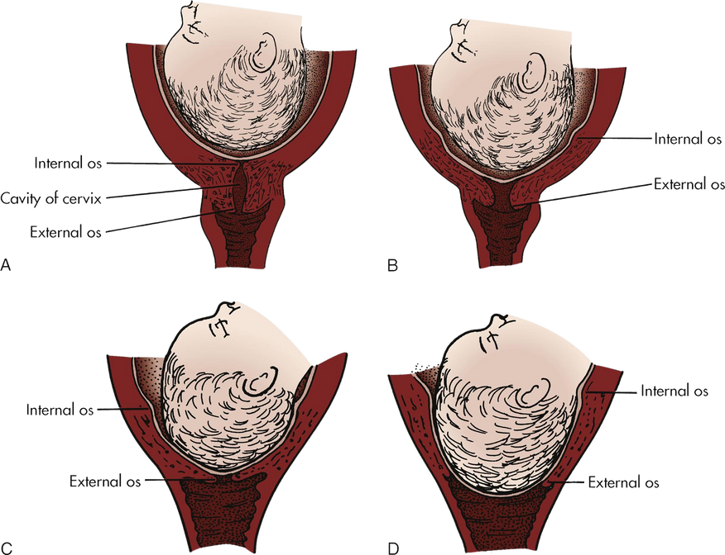
Labor Progress
Dilation
Effacement
Engagement
Widening of cervical opening
0-10 centimeters
Caused by strong uterine contractions and the pressure of the presenting part of the fetus
Shortening and thinning of cervix
Usually progresses more quickly than dilation
Degree expressed in percentages from 0%-100%
Describes the position of the fetus within the maternal pelvis

Slide 6
Stages of Labor
First stage:
Second stage:
Onset of regular uterine contractions to full dilation of the cervix
Latent phase (0-5cm)
Contractions are painful and cause cervical change
Active phase (6-10cm)
Rapid cervical change
Time the cervix is fully dilated to the birth of the infant
Cervix is fully dilated and effaced
Latent: passive fetal descent
Active: pushing
Third stage:
Fourth stage:
Birth of the infant through delivery of the placenta
Delivery of the placenta until woman’s condition is stable (usually 1 hour after birth)

Slide 7
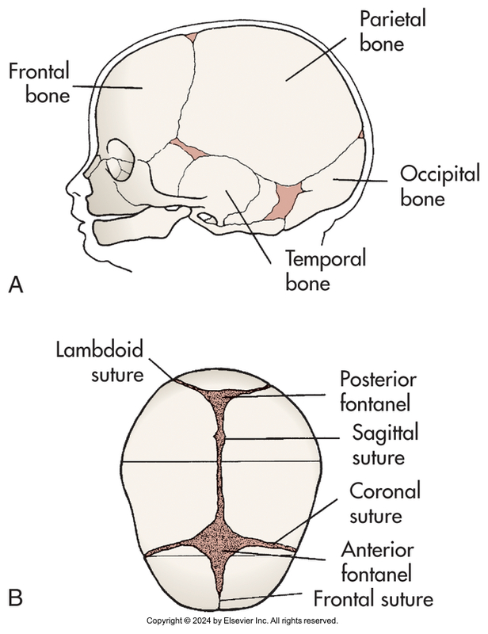
Factors Affecting Labor
Labor & birth are affected by the 5 Ps:
Passenger(s)
Passageway
Powers
Position (of pregnant person)
Psychological response
Fetal head is the major determining factor for course of birth

Slide 8
Is This Labor?
True labor
False Labor
Regular, intense contractions felt in back and/or abdomen
Contractions become stronger, last longer, and occur closer together over time
Cervical change
Irregular contractions felt in back or upper abdomen
Contractions may come and go
Pain/cramping is relieved with position changes or rest
No associated cervical change

Slide 9
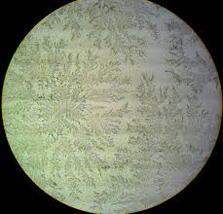
Is This Labor?
Obstetric triage & EMTALA
Signs of labor
Lightening/dropping of the fetus
Bloody show
Determine if water has broken
Nitrazine test for pH
Test for ferning of fluid

Slide 10
Admission to Labor & Delivery
History
Pregnancy history
Symptoms of labor
Physical examination
Vital signs
Leopold’s maneuver
Contraction pattern
FHR & pattern
Vaginal exam
Labs
UA
CBC, type & screen
GBS testing (if needed)
Amniotic fluid
Birth preferences
Birth plan
Desired pain management
Advanced directives

Slide 11
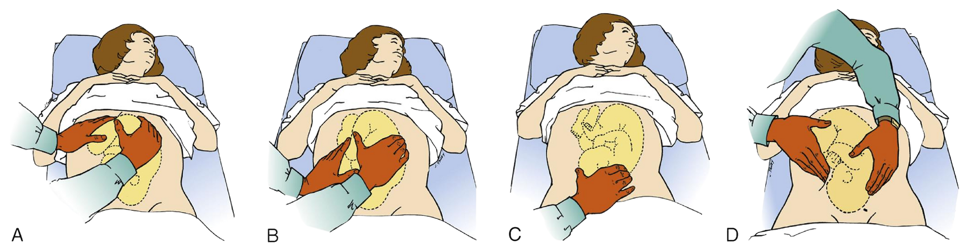
Leopold Maneuvers
Box 19.5, Lowdermilk et al. (2024)

Slide 12
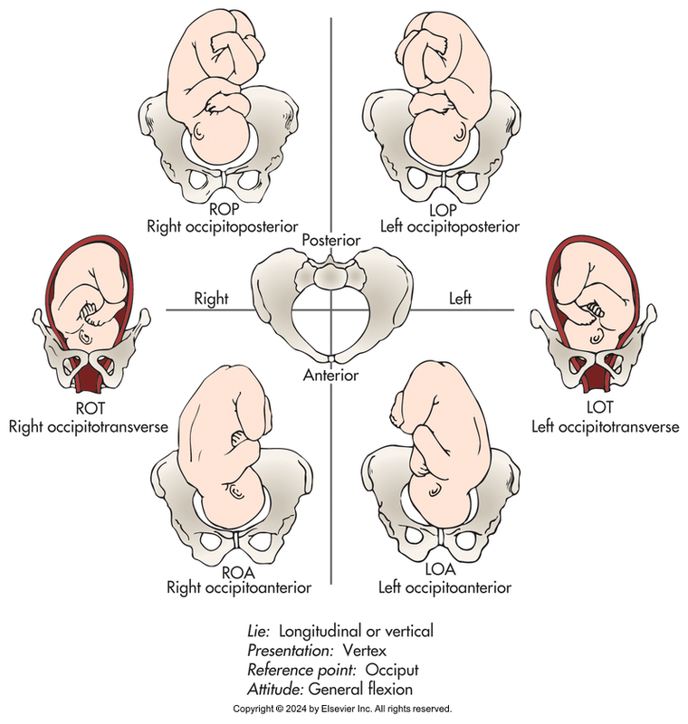
Fetal Presentation
Aka the part of the fetus that enters the pelvic inlet first and leads through the birth canal during labor
Three types:
Cephalic
Breech
Shoulder
Fetal lie: relation of the fetal spine to the maternal spine (either longitudinal or vertical)
Fetal position: relationship of a reference point on the presenting part to the four quadrants of the mother’s pelvis
Figure 16.02, Lowdermilk et al. (2024)

Slide 13
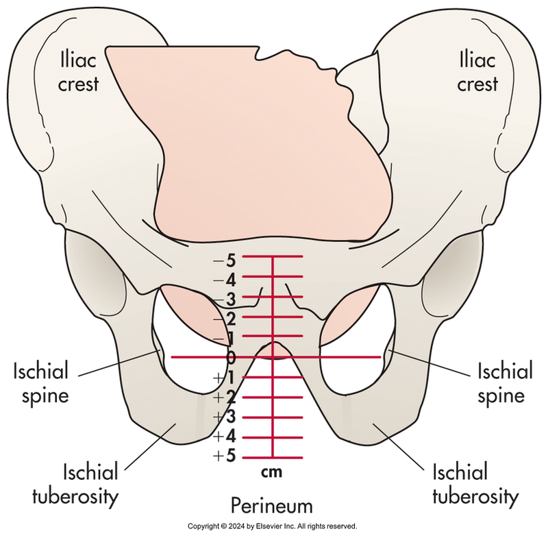
Fetal Presentation
Fetal attitude: relation of the fetal body parts to one another
Fetal station: measure of the degree of descent of the presenting part of the fetus through the birth canal (“engagement”)
Engagement: usually corresponds to 0 (zero) station
Figure 16.06, Lowdermilk et al. (2024)

Slide 14
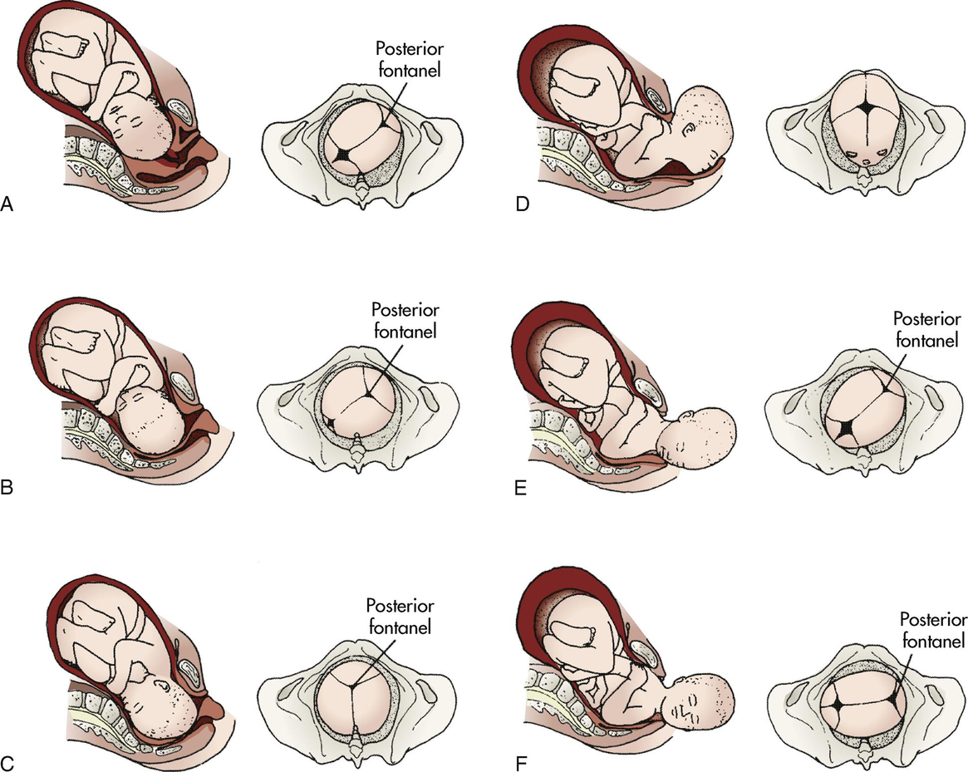
Cardinal Movements
Engagement & descent
Extension
Flexion
External rotation
Internal rotation
Figure 16.12, Lowdermilk et al. (2024)
Expulsion

Slide 15
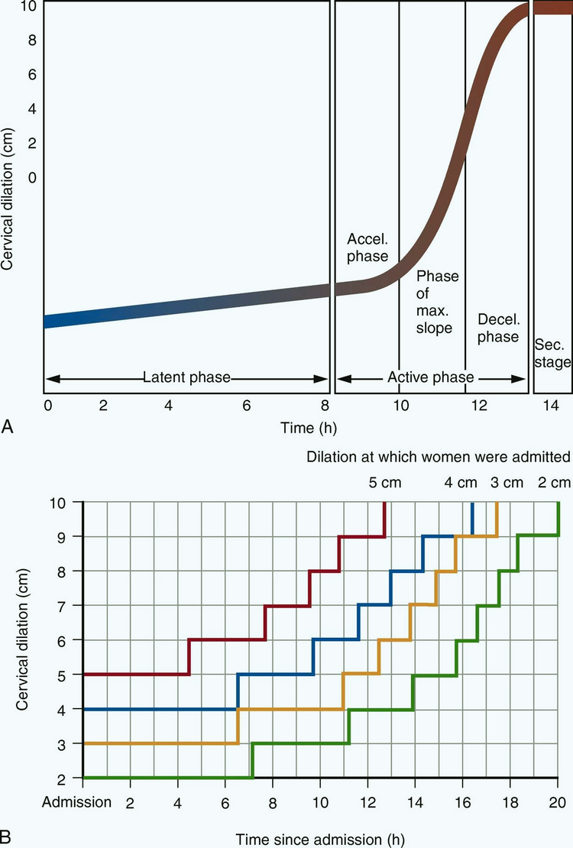
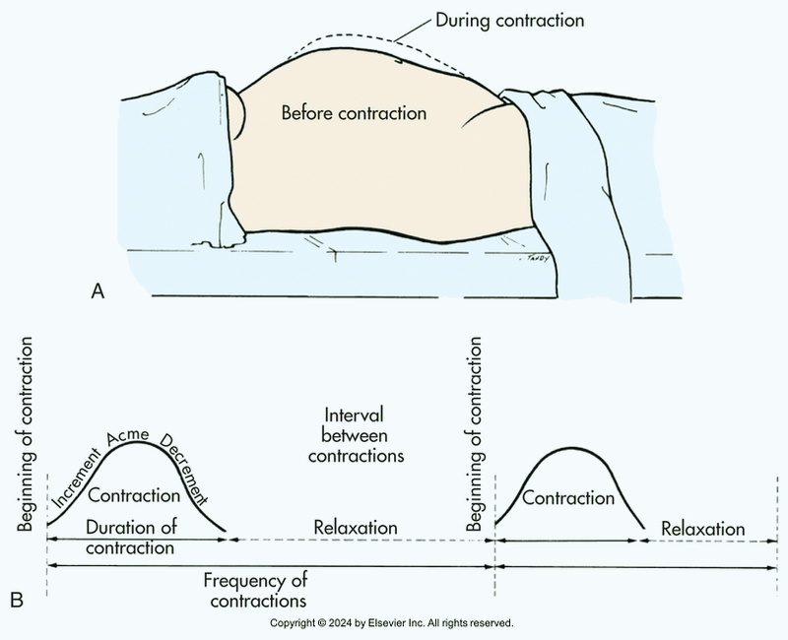
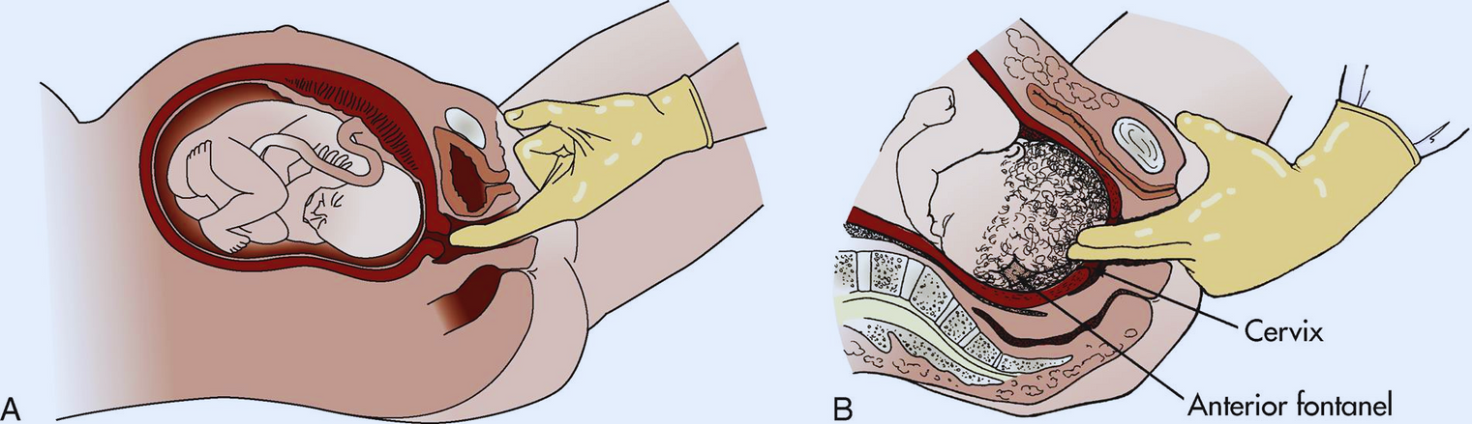
Maternal Assessments During Labor
Cervical changes
Vital signs
Uterine activity/pattern

Slide 16
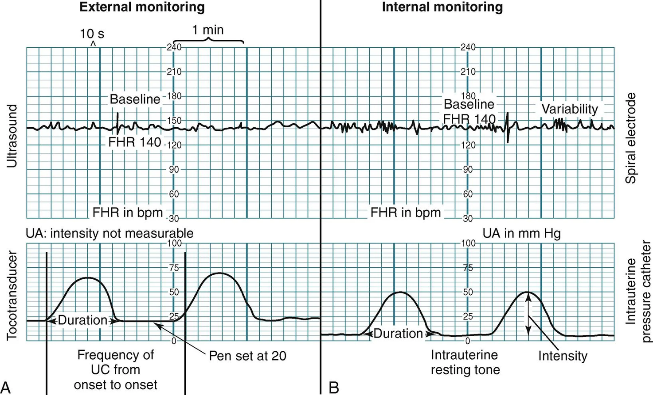

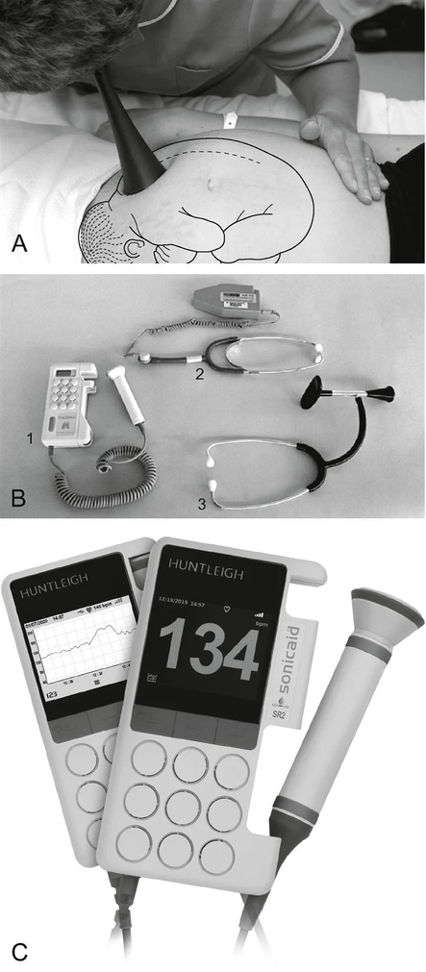
Fetal Assessments During Labor
Fetal heart rate (FHR) tracing
Baseline rate, variability, trends over time
External or internal monitoring
Auscultation
Doppler ultrasound

Slide 17
Pain
Experience of pain is unique to each individual
Gate-Control Theory of Pain:
Pain sensations follow nerve pathways to the brain
Only a limited number of sensations can travel at once
“Distractions” close down a “gate” in the spinal cord and prevent signal transmission
Establish an appropriate pain goal

Slide 18

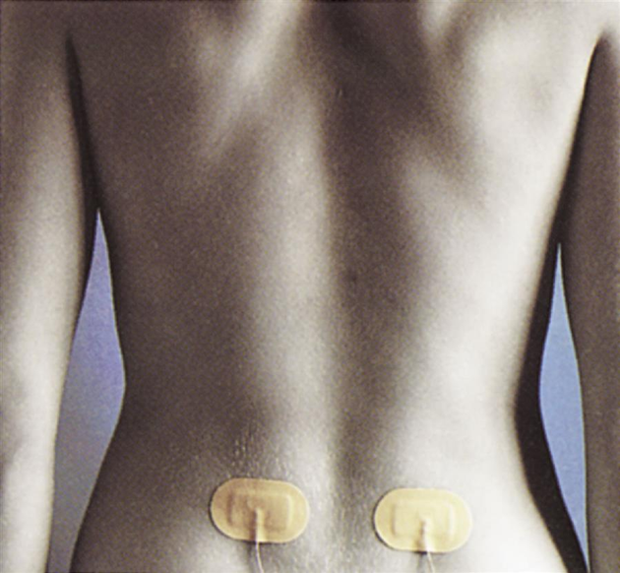
Nonpharmacologic Pain Management
Relaxation and breathing techniques
Counterpressure
Touch/massage
Heat/cold application
Hydrotherapy
Aromatherapy
TENS unit
Hypnosis

Slide 19
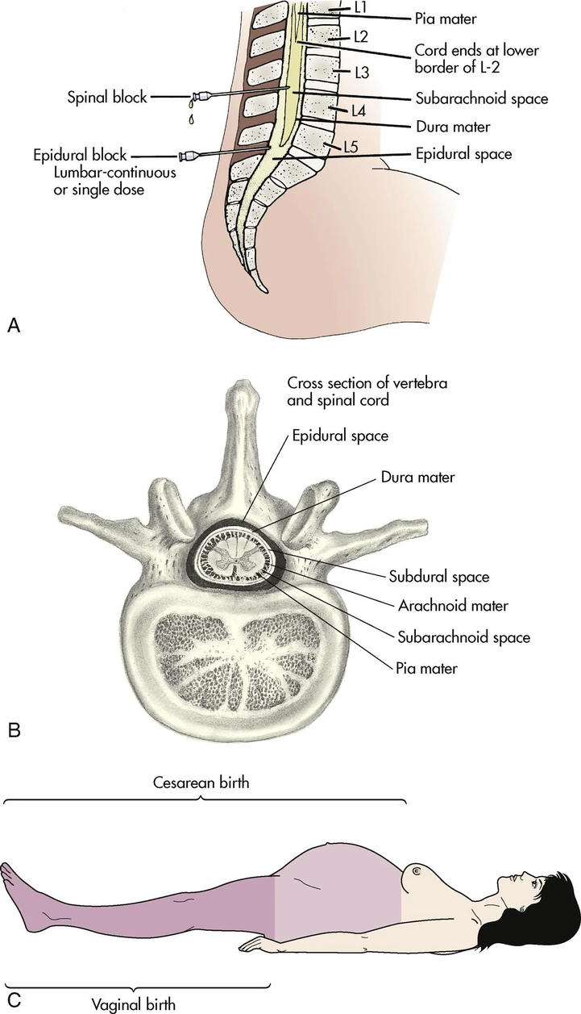
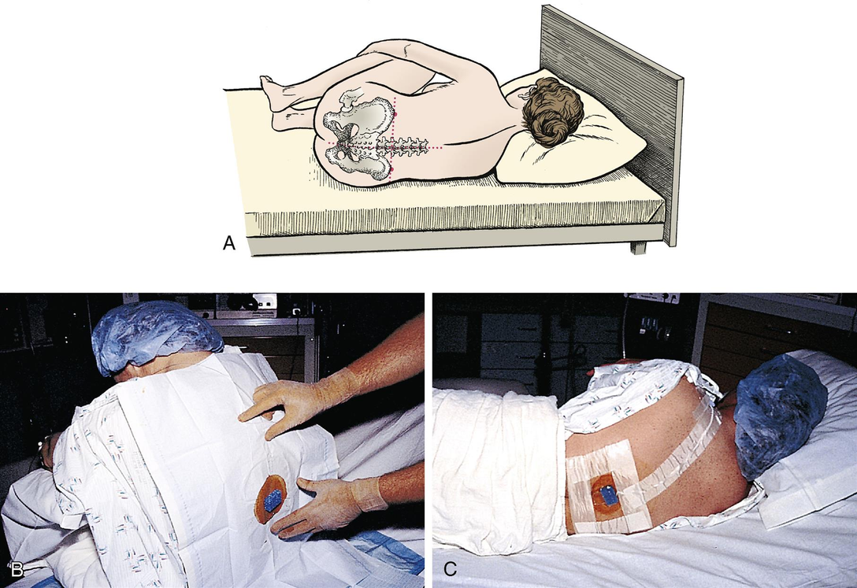
Pharmacologic Pain Management
Opioid medications:
Fentanyl – 50-100mcg q1hr
Caution: can inhibit contractions in early labor
Remifentanil – PCA administration only
Epidural anesthesia
Positioning for placement
Risk of maternal hypotension
Nitrous oxide:
Delivered via facemask PRN
50/50 nitrous oxide and oxygen
Rapid onset, rapid clearance
All anesthesia administration requires informed consent and IV access

Slide 20

Nursing Care During Labor & Delivery
First stage of labor
Basic body functions: fluid status, nutrition, elimination
Move that mom!
Promote a therapeutic environment
Labor support - can be done by nurse or chosen support person
Partner support
Pain management
Involve the woman in decision making regarding her care

Slide 21
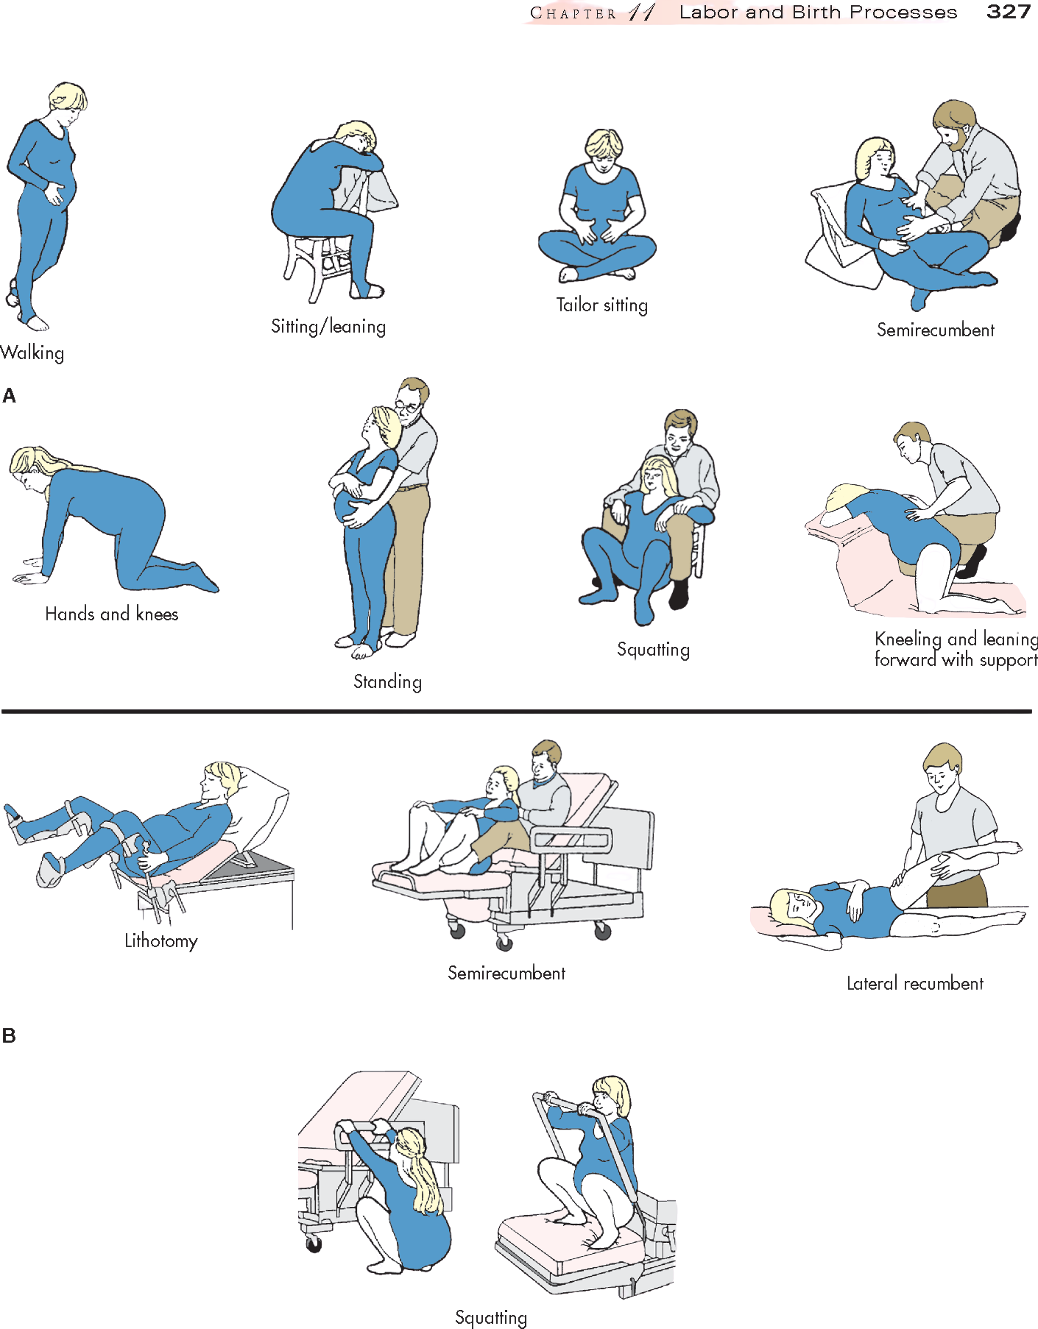
Nursing Care During Labor & Delivery
Second stage of labor
Facilitate maternal position
Lithotomy
Semi-recumbent
Lateral
Upright
Hands and knees
Labor support
Guide bearing down efforts - Valsalva maneuver
Monitoring
Fetal heart rate & pattern
Contraction pattern
Maternal vital signs
Immediate assessment and care of newborn

Slide 22
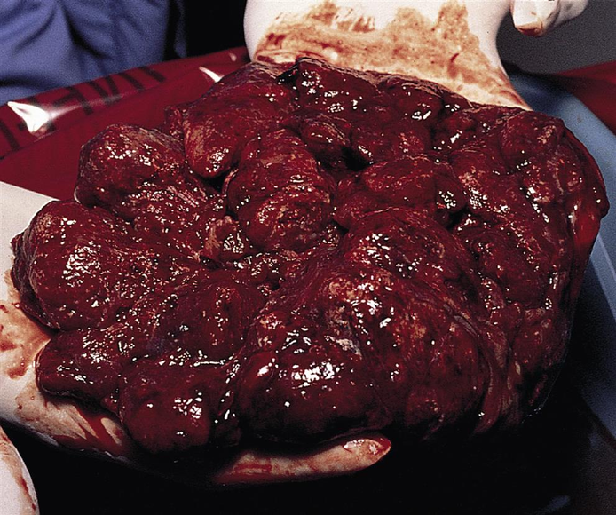
Nursing Care During Labor & Delivery
Third stage of labor
Placenta usually delivered within 15 minutes
Signs of placental separation:
Firmly contracting fundus
Lengthening of the umbilical cord
Gush of blood from vagina
Q15 min VS (or PRN)
Administer oxytocin
Encourage breastfeeding

Slide 23
Nursing Care During Labor & Delivery
Fourth stage of labor
First 1-2 hours after birth - bonding time
Q15min VS for the first 2 hours; temp at least q4hr
Massage the fundus - look for bleeding
Goal is for fundus to be firm and midline
If boggy, massage to promote uterine contraction until firm
Signs of problems:
Excessive blood loss
Alterations in vital signs/level of consciousness

Slide 24
References
Lowdermilk, D. L., Cashion, K., Alden, K. R., Olshandsky, E. F., & Perry, S. E. (2024). Maternity and women’s healthcare (13th ed.). St. Louis: Elsevier.

